Slide 1
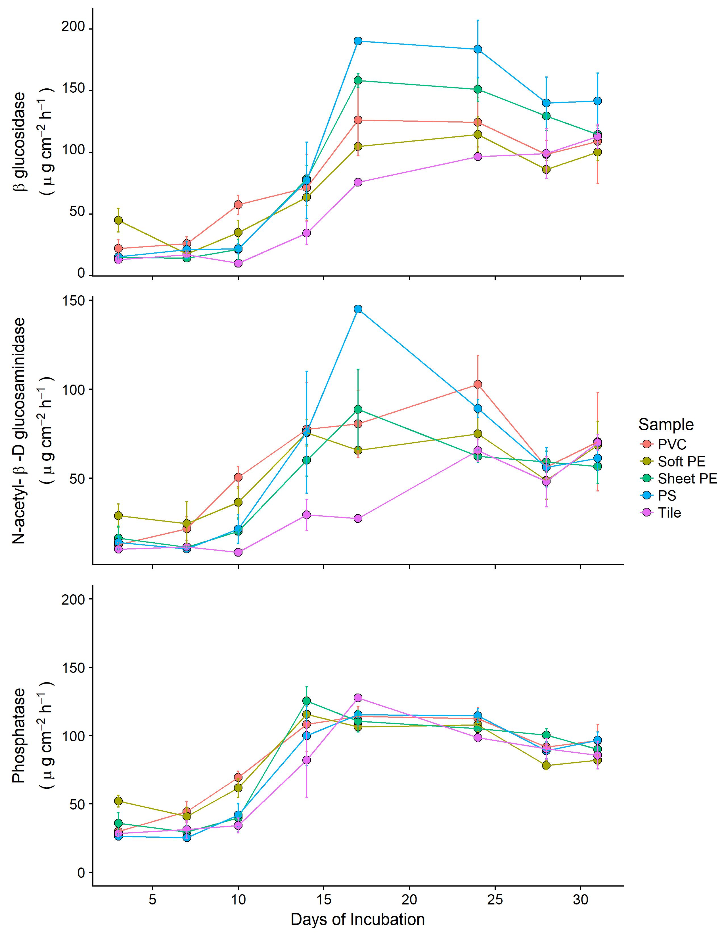
c
b
a
c
a
b
b
b
a

